Slide 1
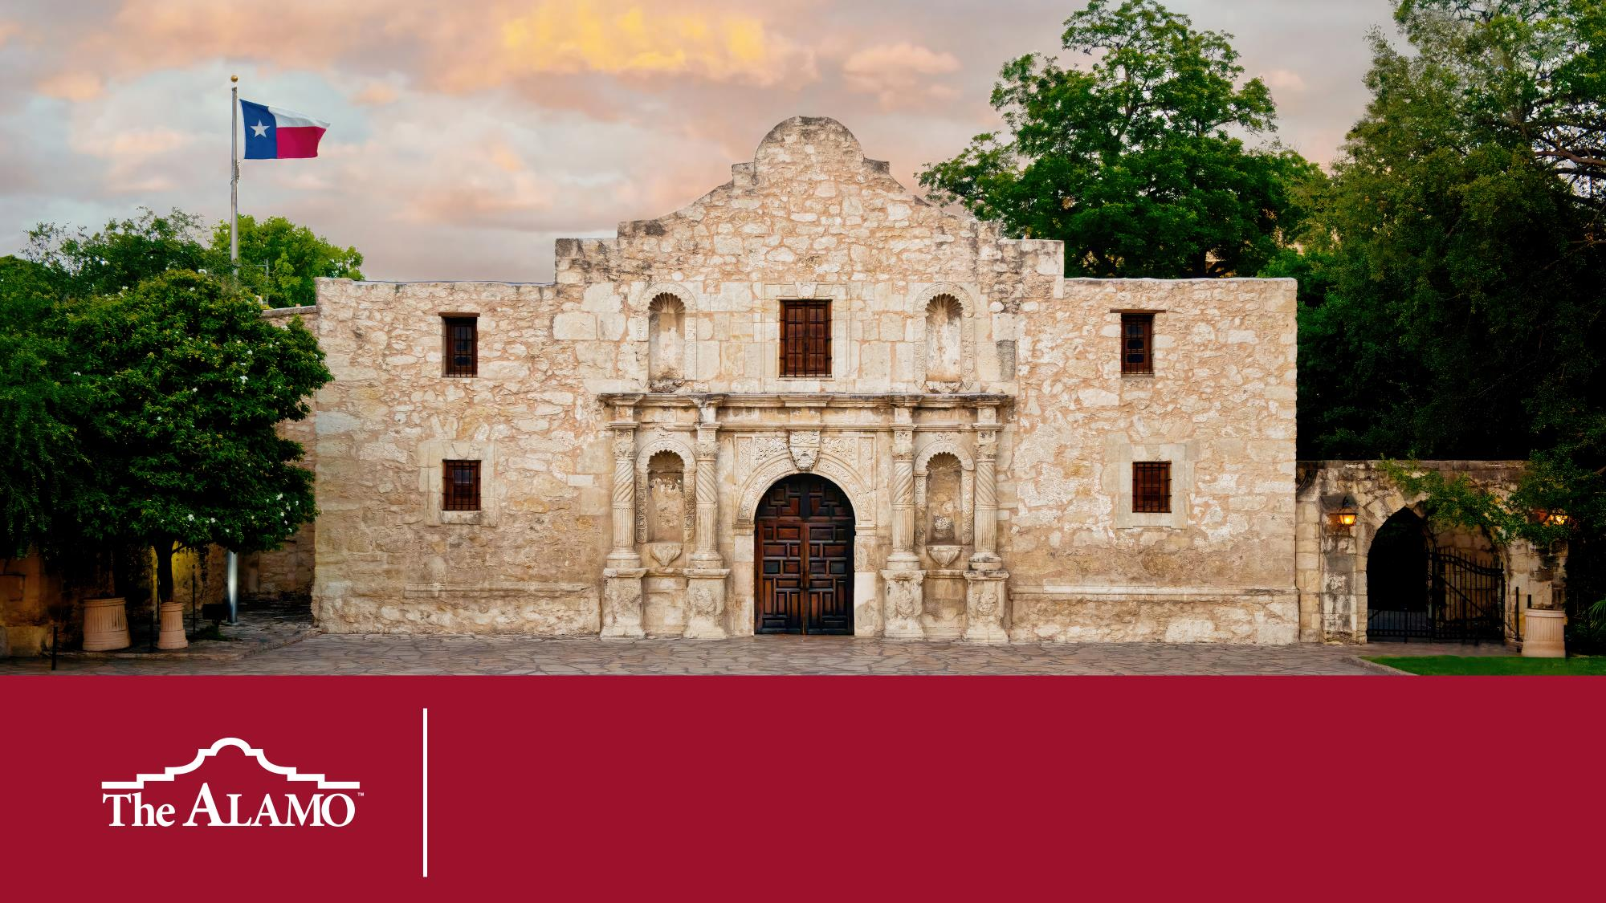
The Spanish Empire Spanish Texas

Slide 2
Dear Educator
Thank you for using this resource and for all that you do every day in your classroom. The purpose of this lesson is for students to infer the purpose and means of Spain’s expansion from primary documents written by monarchs, conquistadores, clerics, and others as they chronicle the rise and fall of the Spanish Empire.
These slides are designed to be student facing and ready to use. For teacher facing notes and suggestions, look at the speaker notes on each slide. If you would like a more in-depth lesson plan, refer to the Spanish Empire Lesson Plan document.
We welcome your feedback as to how we can improve our services to you. If you would like to share any suggestions or comments with us, please email education@thealamo.org.
Lesson Time: 45 – 60 min
Social Studies TEKS: 6.1(A), 6.15(D), 6.2(A), 7.1(A), 7.1(B), WH.22(B), WH.1(D)
Preparation for this Lesson
Print Regions Graphic Organizer and Reflection Questions - 1 per student
Print Document Excerpts - 1 set of each region per class

Slide 3
Focus Question How did the Spanish Empire’s purpose and strategies for expansion change over time and differ across regions?
Notes:
Objectives
Students will identify regions of the Spanish Empire.
Students will outline and describe the expansion and decline of the Spanish Empire.
Students will compare and contrast the purpose and methods of establishing settlements in different regions of the Spanish Empire.

Slide 4
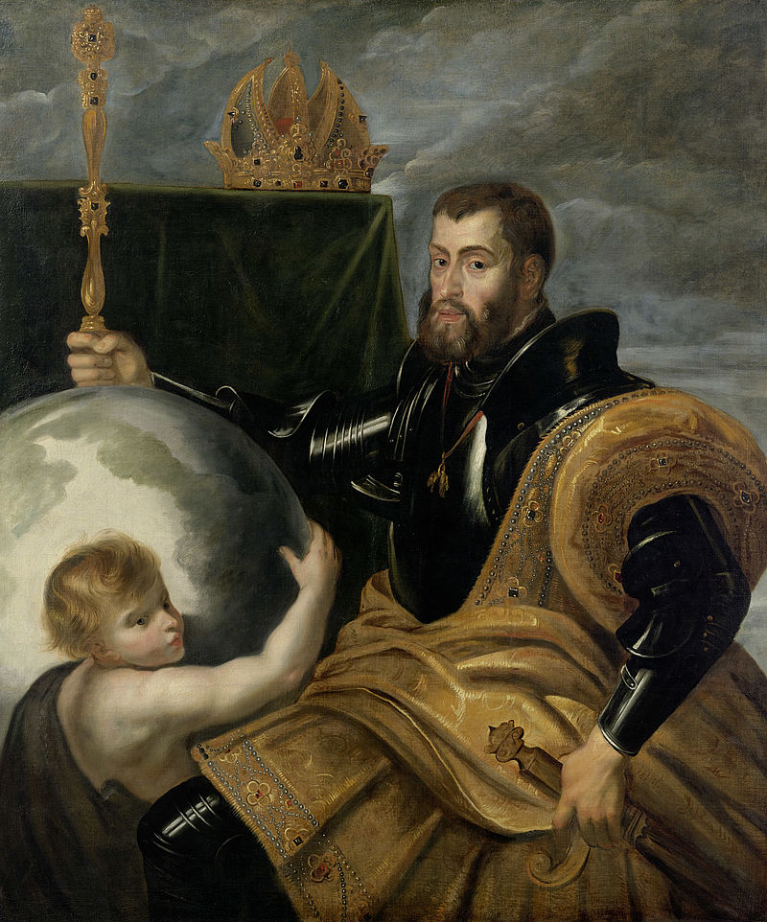


Painting Analysis
Background
This early 1600s painting by Peter Paul Rubens features King Charles V, king of Spain, Germany, and Italy, Archduke of Austria, Lord of the Netherlands, Duke of Burgundy, and Holy Roman Emperor. Charles V oversaw the continuation of settlement in the Americas. His grandmother, Queen Isabella I of Castile, funded Christopher Columbus’s first voyage.
Make a list of everything you can see in the painting.
Peter Paul Rubens (1577-1640), Allegory of Charles V as Ruler of the World (Copy after Francesco Mazzola, called Parmigianino (1503–1540), Allegory of Charles V as Ruler of the World, 1530). Oil on canvas. © Residenzgalerie Salzburg, Illustration Fotostudio Ulrich Ghezzi, Oberalm. Link.
Notes:
Teacher Notes
Introduce the painting as a work by the artist Peter Paul Rubens, completed in the early 1600s. The subject of the painting is Charles V, who lived from 1500 to 1558. He was the king of Spain, Germany, Italy, the Archduke of Austria, the Lord of the Netherlands, the Duke of Burgundy, and the Holy Roman Emperor. Charles V oversaw the continuation of colonization in the Americas. His grandmother, Queen Isabella I of Castile, funded Christopher Columbus’s first voyage.
Display the painting and ask students to list everything they can see in the painting. They can list things individually, in small groups, or as a whole class.
Examples: Globe, man with beard, armor, scepter, crown, sword, cape, cherub

Slide 5
Painting Analysis
Create groups or categories for the components listed in the previous step and determine what they could represent.
This painting is an allegory, meaning it depicts an idea or concept rather than an actual event. What could be the meaning or message of this painting?
Peter Paul Rubens (1577-1640), Allegory of Charles V as Ruler of the World (Copy after Francesco Mazzola, called Parmigianino (1503–1540), Allegory of Charles V as Ruler of the World, 1530). Oil on canvas. © Residenzgalerie Salzburg, Illustration Fotostudio Ulrich Ghezzi, Oberalm. Link.
Notes:
Teacher Notes
Ask students to create groups or categories for the components identified in the previous step and determine what they could represent.
Examples: royalty, military, power, dominance, wealth
Explain to students that this painting is an allegory, meaning that the picture shows an idea or meaning rather than an event that really happened. What could be the meaning or message of this painting?

Slide 6
Poetry Analysis
Background
This excerpt is from Samuel Johnson's poem London, published in 1738. Originally released anonymously, the poem critiques the English government and highlights the plight of London's poor, while also reflecting negative views of Spain. By that time, the Spanish Empire had significant territories in the Americas, while the British Empire stretched across parts of the East Coast of the United States, the Caribbean, and India. These expansions intensified tensions due to colonial rivalries and trade conflicts.
Has heaven reserv’d, in pity to the poor,
No pathless waste, or undiscover’d shore;
No secret island in the boundless main?
No peaceful [desert] yet unclaim’d by Spain?
Samuel Johnson
Johnson, Samuel, 1709-1784. London: a Poem, in Imitation of the Third Satire of Juvenal. [London] :[publisher not identified], 17401749.
Notes:
Teacher Notes
Present the work as an excerpt from English writer Samuel Johnson’s poem London, published in 1738. Originally published anonymously, the poem criticizes England’s government and laments the conditions of London’s poor, while also reflecting the widespread negative views many English people held toward Spain. By 1738, the Spanish Empire encompassed large parts of South America, North America, and the Caribbean, while the British Empire included much of the modern-day East Coast of the United States, as well as parts of the Caribbean and India. The expansion of the two empires heightened tensions through colonial rivalry, trade conflicts, and territorial disputes.

Slide 7
Poetry Analysis
What is the poem’s tone or mood?
Who is the speaker and the intended audience?
Write one or two sentences paraphrasing or rewriting the excerpt.
Determine the excerpt’s message or purpose. How does the speaker feel about the subject? What is the speaker trying to convey to the audience?
Has heaven reserv’d, in pity to the poor,
No pathless waste, or undiscover’d shore;
No secret island in the boundless main?
No peaceful [desert] yet unclaim’d by Spain?
Samuel Johnson
Johnson, Samuel, 1709-1784. London: a Poem, in Imitation of the Third Satire of Juvenal. [London] :[publisher not identified], 17401749.
Notes:
Teacher Notes
Post or print the poem, then have students read it independently or in small groups and determine the excerpt’s tone or mood. Happy? Melancholy? Angry?
Have students identify the speaker in the excerpt and the intended audience. Remind students that this excerpt was published in a longer poem in London in 1738.
Ask students to write one or two sentences paraphrasing or rewriting the excerpt.
Have students determine the excerpt’s message or purpose. How does the speaker feel about the subject? What is the speaker trying to convey to the audience?

Slide 8
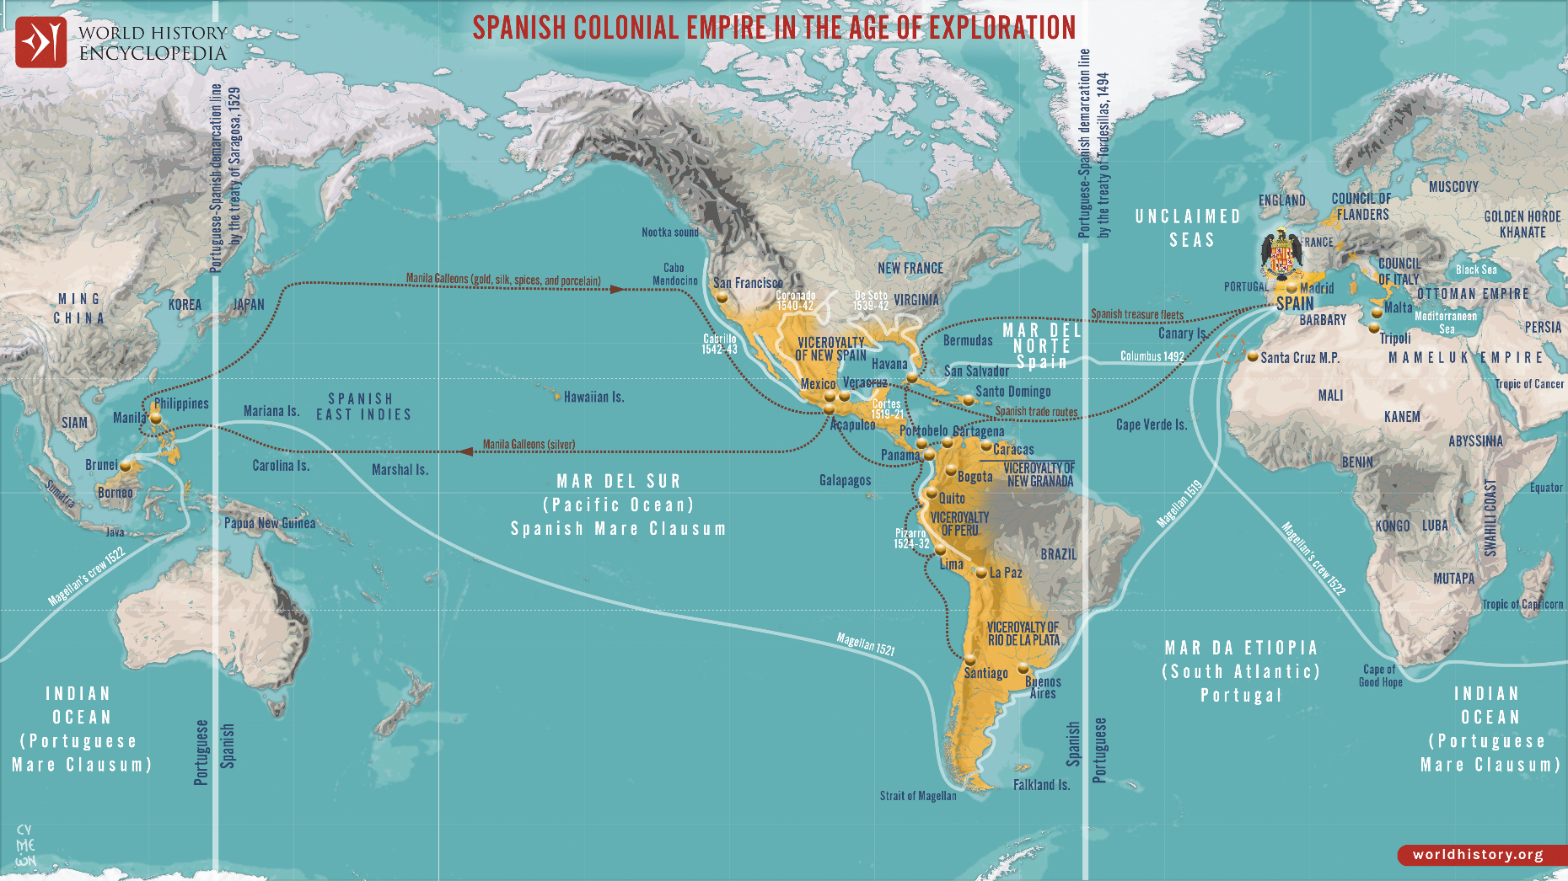
The Spanish Empire
Netchev, S. (2021, August 04). Map of the Spanish Colonial Empire. World History Encyclopedia. https://www.worldhistory.org/image/14411/map-of-the-spanish-colonial-empire/
Notes:
Teacher Notes
Provide students with background on the initial expansion of the Spanish Empire. Explain to students that Spain’s expansion is often attributed to the three G’s: God, gold, and glory. In this lesson, they will analyze primary and secondary documents that showcase the motivations and actions of those involved in Spain’s expansion across six regions.

Slide 9
Document Analysis
Each group will be assigned a different region: The Philippines, Peru, the Caribbean, Mexico, North Africa, or the United States (Texas, Florida, and New Mexico).
In your groups, you will receive five document excerpts. Read these and annotate:
Evidence of purpose: highlight phrases that explain why Spain established settlements in that region. You can color-code according to the three G’s or another preferred method.
Evidence of methods: highlight phrases that describe how Spain entered the region and established settlements there.
Notes:
Teacher Notes
Break students into at least six groups, and assign each group a different region:
The Philippines
Peru
Caribbean
Mexico
North Africa
United States (Texas, Florida, and New Mexico)
In their groups, students will read excerpts from their region's documents and annotate:
Evidence of purpose. Students should highlight phrases that explain why Spain established settlements in that region. They can color-code according to the three G’s or another preferred method.
Evidence of methods. Students should highlight phrases that describe how Spain entered the region and established settlements there.

Slide 10

Document Analysis
Discuss in your small groups and decide on two or three highlighted phrases that best demonstrate both the purpose and the methods of Spanish expansion.
Notes:
Teacher Notes
After annotating, students discuss in their small groups and decide on two or three highlighted phrases that best demonstrate both the purpose and the methods of Spanish expansion.

Slide 11
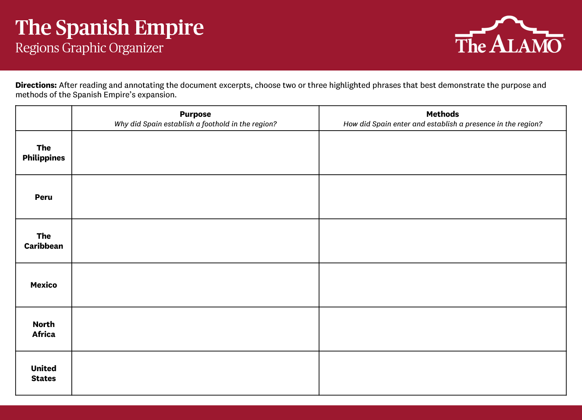
Document Analysis
Write these phrases for your region in the Regions Graphic Organizer.
Notes:
Teacher Notes
Once identified, students then write these phrases for their respective region in the Regions Graphic Organizer.

Slide 12

Document Analysis
You’ll now be put into groups of six, with one student representing each region. You will be the expert of your region, teaching your group what you learned as they fill in their graphic organizers.
Notes:
Teacher Notes
After each group is done , have a representative share their main takeaways and their responses to the questions. Have a class scribe take notes for each region on the whiteboard or chart paper.
Alternatively, have each student act as the “EXPERT” of their region. Put students in groups of 6 (one from each region). Each will teach the rest in their respective regions while the others fill in their charts.

Slide 13
Reflection Questions
What led to the expansion of the Spanish Empire?
What similarities and differences did you notice between Spain’s settling in different areas?
What are some unintended consequences of the Spanish Empire establishing settlements across the world?
The goals of growing the Spanish Empire are often attributed to the three G’s: God, gold, and glory. How would you explain the three G’s to someone who has never heard of them?
If Spain hadn’t expanded into these regions, what is one thing that could be different in today’s world?
What overarching statement can you make to best describe the Spanish Empire?
Notes:
Teacher Notes
To conclude the lesson, discuss as a class or in small groups the Reflection Questions side of the student sheet.

