Slide 1
Establishing Colonies in Texas
Primary Source Excerpt Cards
Mexico City Commission opinion presented to the Sovereign Governing Board of the Mexican Empire
“The most important problem is the security of the Province of Texas… It would be an irreparable loss to the Empire if this beautiful Province is lost. In order to save it there remains only one recourse—to populate it.”
Mexican Government Official
José Maria Sanchez, a member of Mexico’s artillery corps, accompanied Manuel Mier y Téran on his investigations of Texas, “A Trip to Texas in 1828”​
“Although the soil is very rich, the inhabitants do not cultivate it because of the danger incurred from Indian attacks as soon as they get any distance from the houses, as the Indians often lurk in the surrounding country…” ​
“No measures can be taken for the maintenance of a continuous watch on account of the sad condition of the troops, especially since they lack all resources. For months, and even years at times, these troops have gone without salary or supplies, constantly in active service against the Indians, dependent for their subsistence on buffalo meat, deer, and other game they may be able to secure with great difficulty. The government, nevertheless, has not helped their condition in spite of repeated and frequent remonstrances.” ​
Mexican Government Official
1
Mexican Rule and Texas Revolution

Slide 2
Lesson Plan: Colonizing Texas
Primary Source Excerpt Cards
Representative Argandar from Michoacan in debates of November 23 and November 26, 1822
“If they wish to come, they will do under the condition that they will not have slaves. This will be the highest honor of the Mexican nation.”
Mexican Government Official
Governor Antonio Martinez to Gaspar Lopez on February 6, 1822
“It is absolutely necessary that the nation make some effort to populate it… admitting foreigners would be the easiest, least expensive, and fastest mode.”
Tejano Resident
Governor Antonio Martinez 1820
“From now on, I am not responsible for defending and controlling this province that has been placed under my protection.”
Tejano Resident
Mexican Rule and Texas Revolution
2

Slide 3
Lesson Plan: Colonizing Texas
Primary Source Excerpt Cards
Jose Francisco Ruiz to Stephen F. Austin on Nov. 30, 1826
“I cannot help seeing the advantages which, to my way of thinking, would result if we admitted honest, hardworking people, regardless of what country they come from… even hell itself.”
Tejano Resident
Stephen F. Austin to Joseph H. Hawkins on July 20, 1821
“The objects of this settlement are entirely agricultural. This richness of the soil, healthfulness of the climate, contiguity to the sea, and other natural advantages, promising a reward to our labors, which few spots on the globe could furnish to an equal extent… I hope the newspapers in Mississippi, Tennessee, Kentucky, and Missouri will republish.”
Anglo Colonist
Stephen F. Austin quoted in the Richmond Enquirer November 20, 1821
“…to each individual settler at least 1000 acres of land, for agricultural purposes, and an additional quantity to settlers in proportion to the size of their families, number of their slaves, and resources they possess for cultivating the soil.”
Anglo Colonist
Mexican Rule and Texas Revolution
3

Slide 4
Lesson Plan: Colonizing Texas
Primary Source Excerpt Cards
Stephen F. Austin’s diary on first trip to Texas on September 17, 1821, page 21
“These Indians… may be called universal enemies to man… An American population will be the signal of their extermination for there will be no way of subduing them but extermination.”
Anglo Colonist
Stephen F. Austin to Edward Lovelace on Nov. 22, 1822
“The principal difficulty is slavery, this they will not admit - as the law is all slaves are to be free in ten years, but I am trying to have it amended so as to make them slaves for life and their children free at 21 years - but do not think I shall succeed in this point…”
Anglo Colonist
Guerrero Decree:
1. Slavery is abolished in the republic.
2. Those who up to now had been considered as slaves are therefore free.
3. When the circumstances of the treasury allow it, slave owners will be indemnified in the terms provided by law.
And so that everything contained in this decree has its fullest compliance, I command that it be printed, published and circulated to those who correspond.
Anglo Colonist
Mexican Rule and Texas Revolution
4

Slide 5
Criminal Regulations in Austin’s Colony June 1824
Article 1: on the appearance of any Indian or Indians in the neighborhood of any of the settlements of this colony, whose conduct justified a belief that their intentions are to still, or community hostilities, or who threaten any settler, or are rude to women or children, it shall be the duty of all and every person to take such Indian or Indians into custody, if in his or their powder to do so, and convey them forthwith to the nearest alcalde, or captain of militia, avoid the use of arms in all cases, unless compelled to resort to them.
Article 2: In case the Indian or Indians mentioned in the last article should be so numerous as to require a strong party to take them, and the men in the immediate neighborhood are insufficient, it shall be the duty of the person who first discovered them, or who are the most interested in their removal, to give notice thereof to the nearest captain of the militia…
Articles 10-14 relate to runaway slaves, kidnapping enslaved individuals, theft by enslaved people etc.
Article 25: Should any piratical or other vessels of a doubtful or suspicious character appear on the coast, or enter any river or inlet within this colony, it should be the duty of the person or persons who discovers them to give immediate information to the nearest alcalde, or to the political chief of the colony.
Anglo Colonist
Mexican Rule and Texas Revolution
5

Slide 6
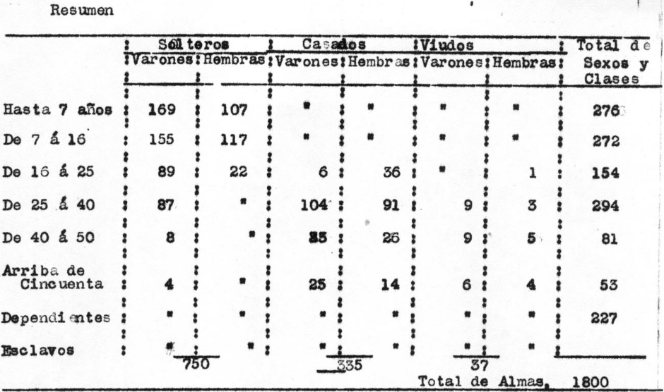
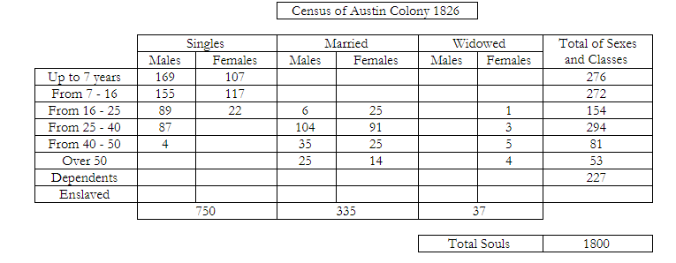
Census of Austin Colony 1826
Anglo Colonist​
Census of Austin Colony 1826
Anglo Colonist​
Mexican Rule and Texas Revolution
6

