Slide 1
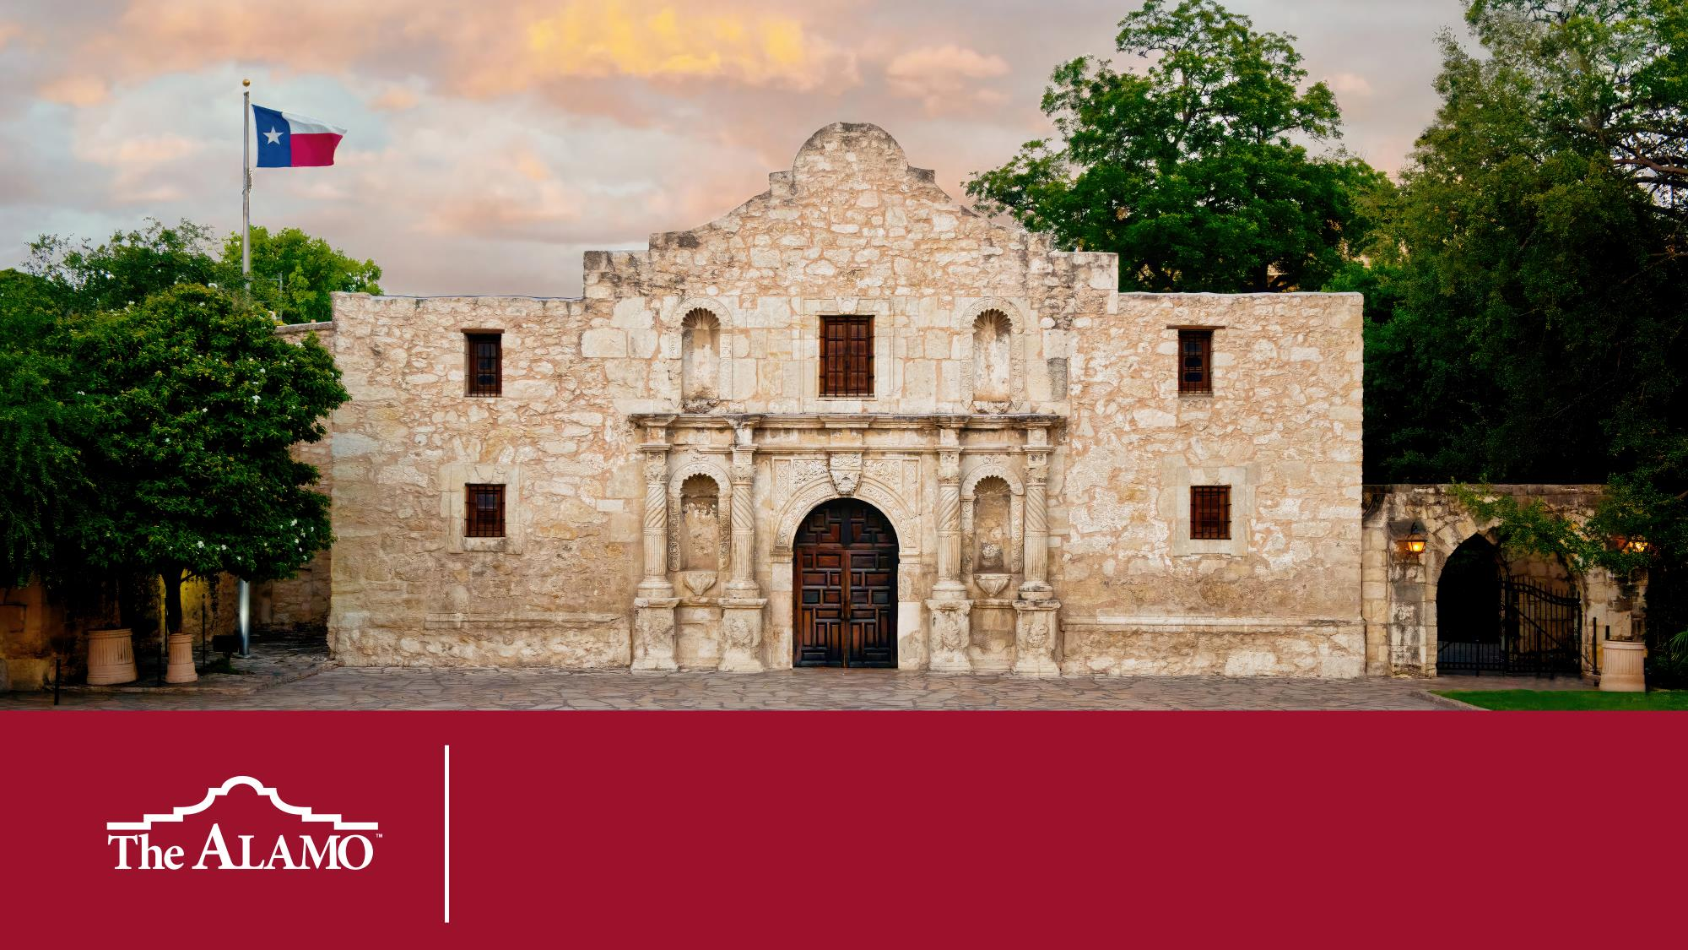
Alamo Investigators

Slide 2
Dear Educator
Thank you for using this resource and for all that you do every day in your classroom. The purpose of this lesson is for students to evaluate the circumstances that fostered the transition of Mission San Antonio de Valero into a military outpost known as the Alamo. ​
These slides are designed to be student facing and ready to use. For teacher facing notes and suggestions, look at the speaker notes on each slide. If you would like a more in-depth lesson plan, refer to the Mission to Fort Lesson Plan document. ​
We welcome your feedback as to how we can improve our services to you. If you would like to share any suggestions or comments with us, please email education@thealamo.org.
Lesson Time: 90 min
TEKs
SS: 7.1(B), 7.3(B), 7.3(C), 7.20A, 7.20(C)
Preparation for this Lesson
Evidence (10 Firsthand Accounts)
Graphic Organizers – 1 per student
Load the Battle of the Alamo Diorama video and make sure the sound is working.

Slide 3
Focus Question How do historians create an accurate historical narrative?
Notes:
Objectives
In this lesson, through collaborative activity and presentation, students explore a pivotal event in the Texas Revolution by putting themselves into the shoes of historians tasked with putting together a cohesive, accurate narrative with a limited set of evidence.

Slide 4
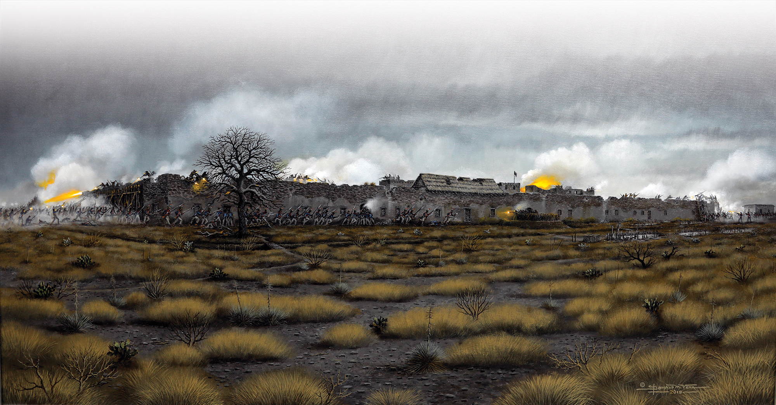
The Battle of the Alamo: A Pivotal Moment
“First Light, Gunsmoke, Bayonets and Texas History” by Donald M. Yena, Alamo Collection
Notes:
Explain context to students: The Battle of the Alamo was a pivotal moment in the war between Texas and Mexico. Historians are tasked with answering important questions about consequential events in history. Who was there, what happened, and what does it mean? These are important questions, and finding accurate answers is difficult and complicated with events like the battle. Only a few first-person accounts exist. There are no photographs from the battle. What was once a battlefield is now in the middle of downtown San Antonio, making the task even more complex.

Slide 5


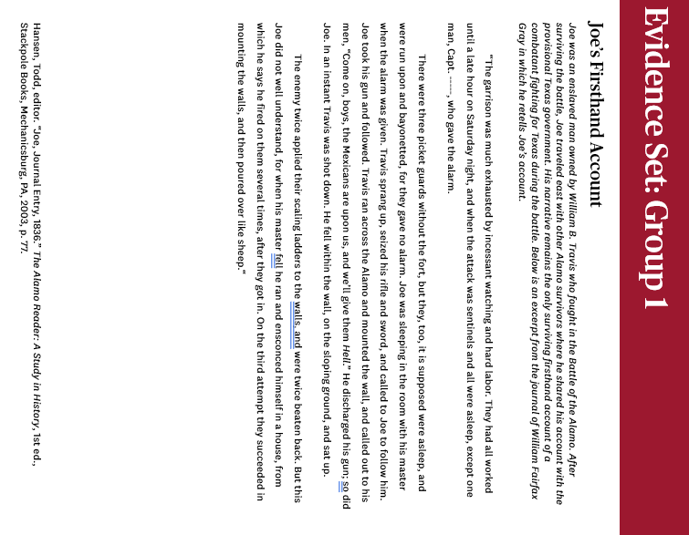
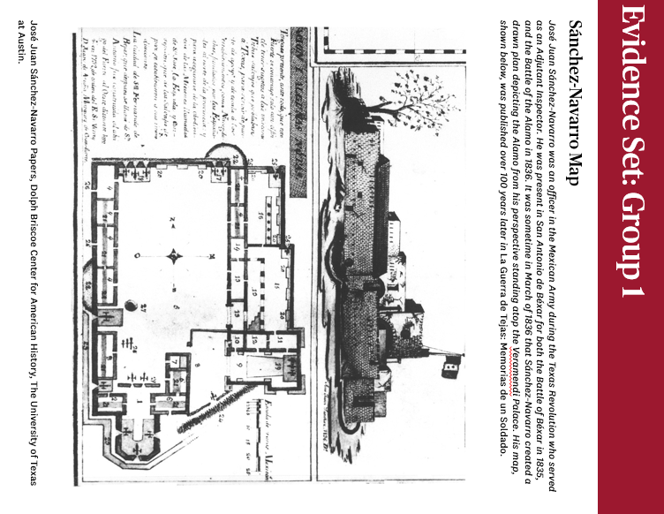
Directions
Your Role: Historian Investigator.
Your Mission: Piece together an accurate narrative of what happened at the Battle of the Alamo.
Your evidence will be limited, but you will have to do your best to draw conclusions about who was there and what happened.
Alamo, Battle of the
TOP SECRET

Slide 6
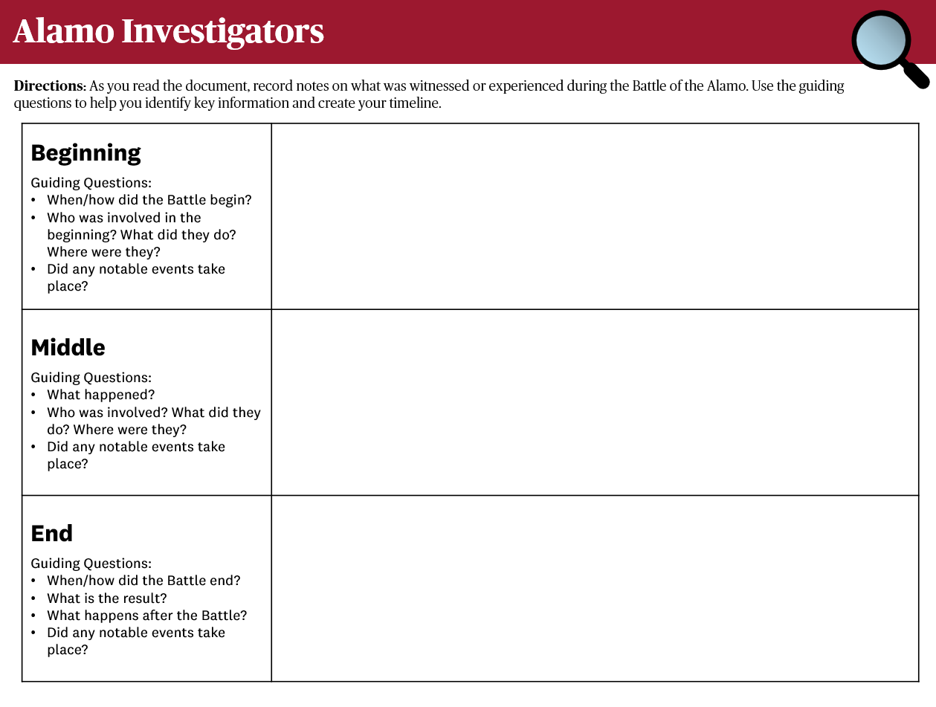
Directions
Read through your Firsthand Account and take notes in your Graphic Organizer.
Use the guiding questions to help you identify key information and create your timeline.
Notes:
To help students with constructing a timeline, review the guiding questions on Part 1 of the graphic organizer. Remind students that the person who wrote their firsthand account may not have all the details. They should just fill in as much information as possible.

Slide 7
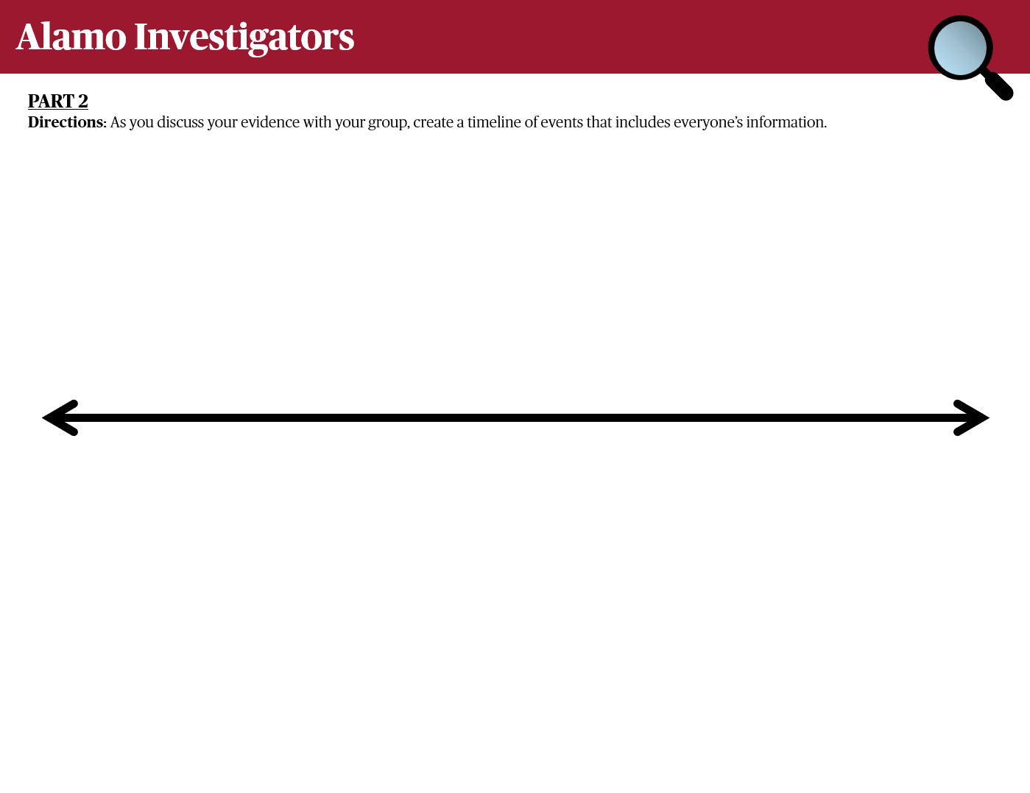
Directions
Create a timeline that incorporates everyone’s findings.
If your information does not match someone else’s, try to come to a consensus.
Remember: your goal is to create a timeline of key events that span the entire battle!
Notes:
As they listen to the members of their group, students create a timeline that incorporates everyone’s findings on Part 2 of the graphic organizer. Remind them that their goal is to create a timeline that spans the whole battle with key events noted.
Some firsthand accounts contradict each other. If students are debating, encourage conversation around how historians determine whose account may be more accurate. Encourage groups to come to a consensus.

Slide 8

Directions: Whole Group Timeline
Write as much information as you can on sticky notes – one sticky note per fact/event.
Post your event sticky notes on the wall or whiteboard to create a whole group timeline.

Slide 9

Directions: Whole Group Timeline
Read through everyone’s sticky notes.
Discuss any contradictions or corroborations you notice.

Slide 10
Reflection Questions
What questions did the evidence sets answer about the Battle of the Alamo? What questions were not answered?
How did the first-hand accounts corroborate or contradict each other?
Why is it difficult for historians to create accurate narratives for events that took place a long time ago?
Notes:
In small groups or as a class, discuss the following reflection questions:
What questions did the evidence sets answer about the Battle of the Alamo? What questions were not answered?
How did the first-hand accounts corroborate or contradict each other?
Why is it difficult for historians to create accurate narratives for events that took place a long time ago?

Slide 11
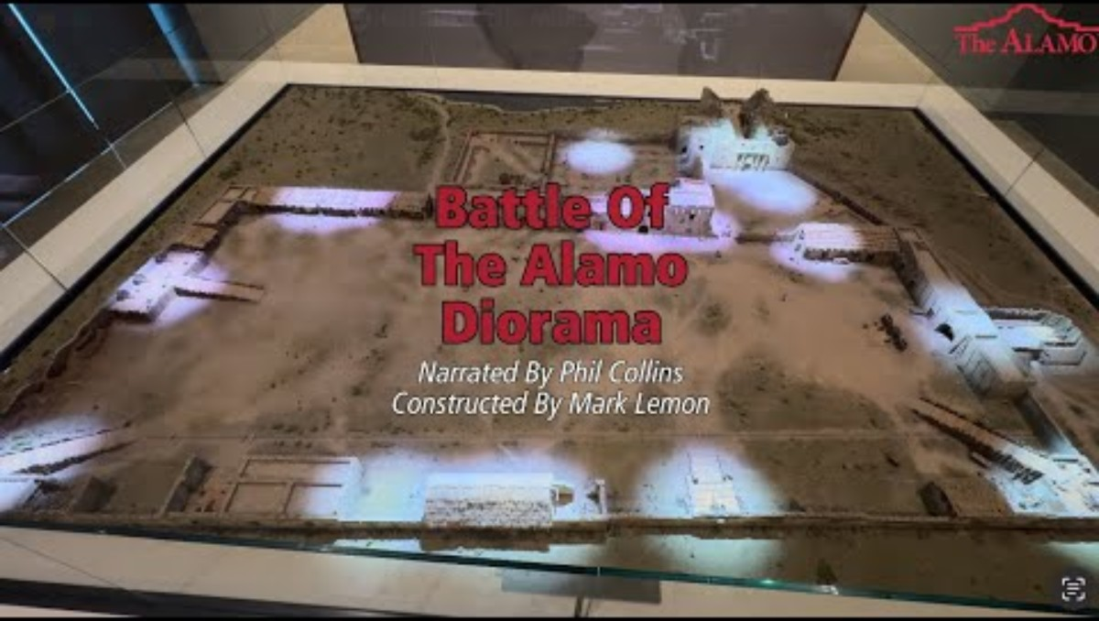
Notes:
After each group has presented, as a class, watch the Battle of the Alamo Diorama video that explains the details of the battle.

Slide 12
Assessment
Students can demonstrate their learning by taking the most important information from their graphic organizer and synthesizing it through one of the following:
Writing a one to two-page narrative
A letter written home by an eyewitness
A newspaper article written after the fact
A story board timeline
A graphic novel

